Slide 1
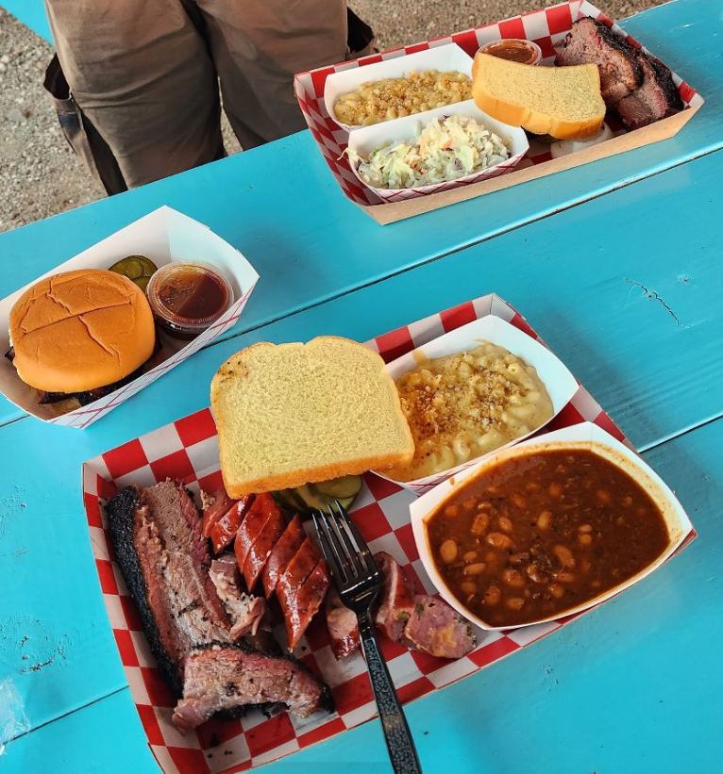
BBQ Bonanza
PHYS 351.01
Joshua Murphy, MinJun Baik, Sidney Osae - Asante

Slide 2
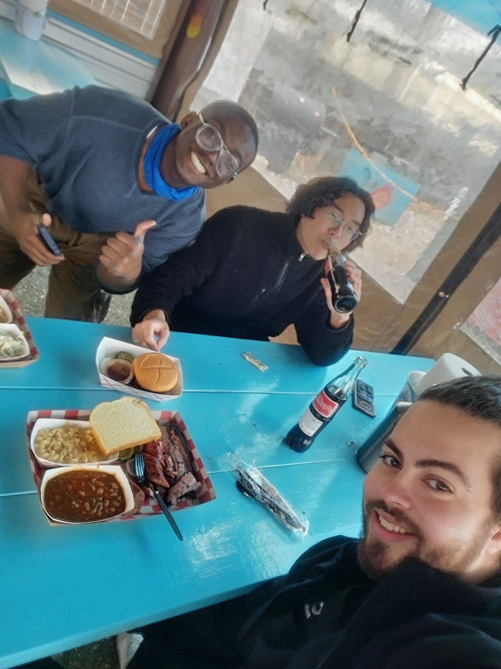
Table of Contents
Overview
Problem, Goal and Criteria
Setup
Hardware
Computational technique
Data measurement
Experiment and result
Procedures
Problems and solutions
Data analysis
Applied Numerical Methods
Conclusion
“Also reason why we were late in Dr.D’s class”

Slide 3
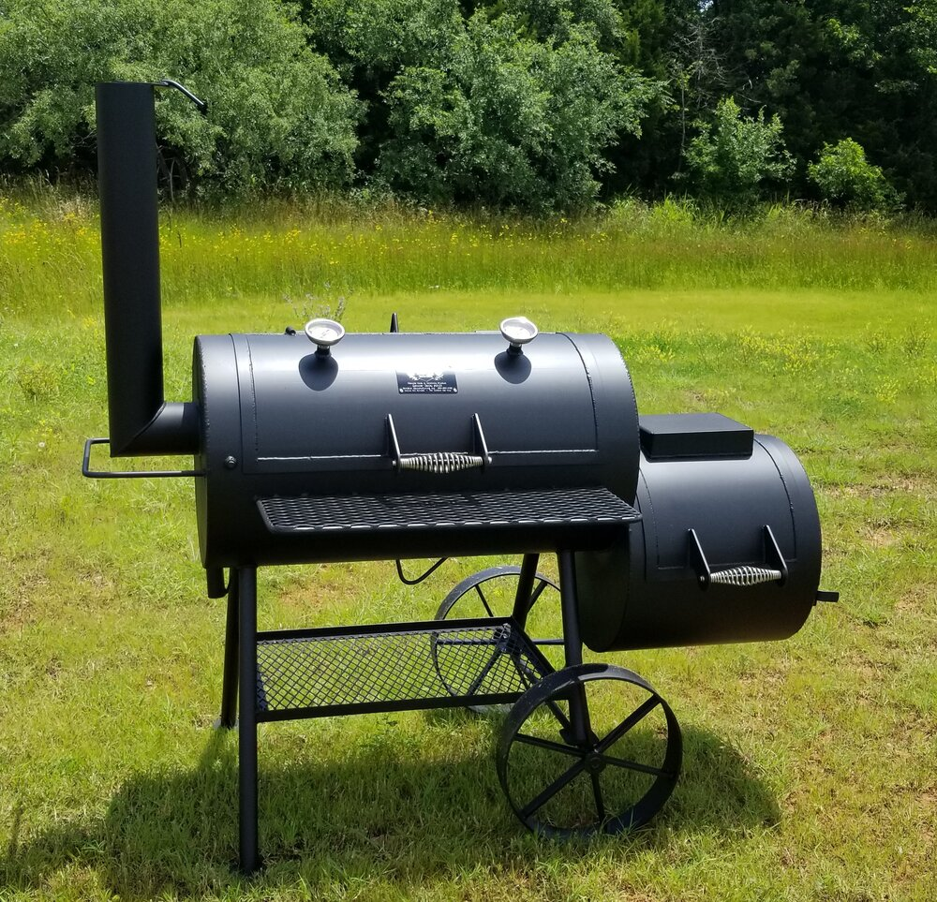
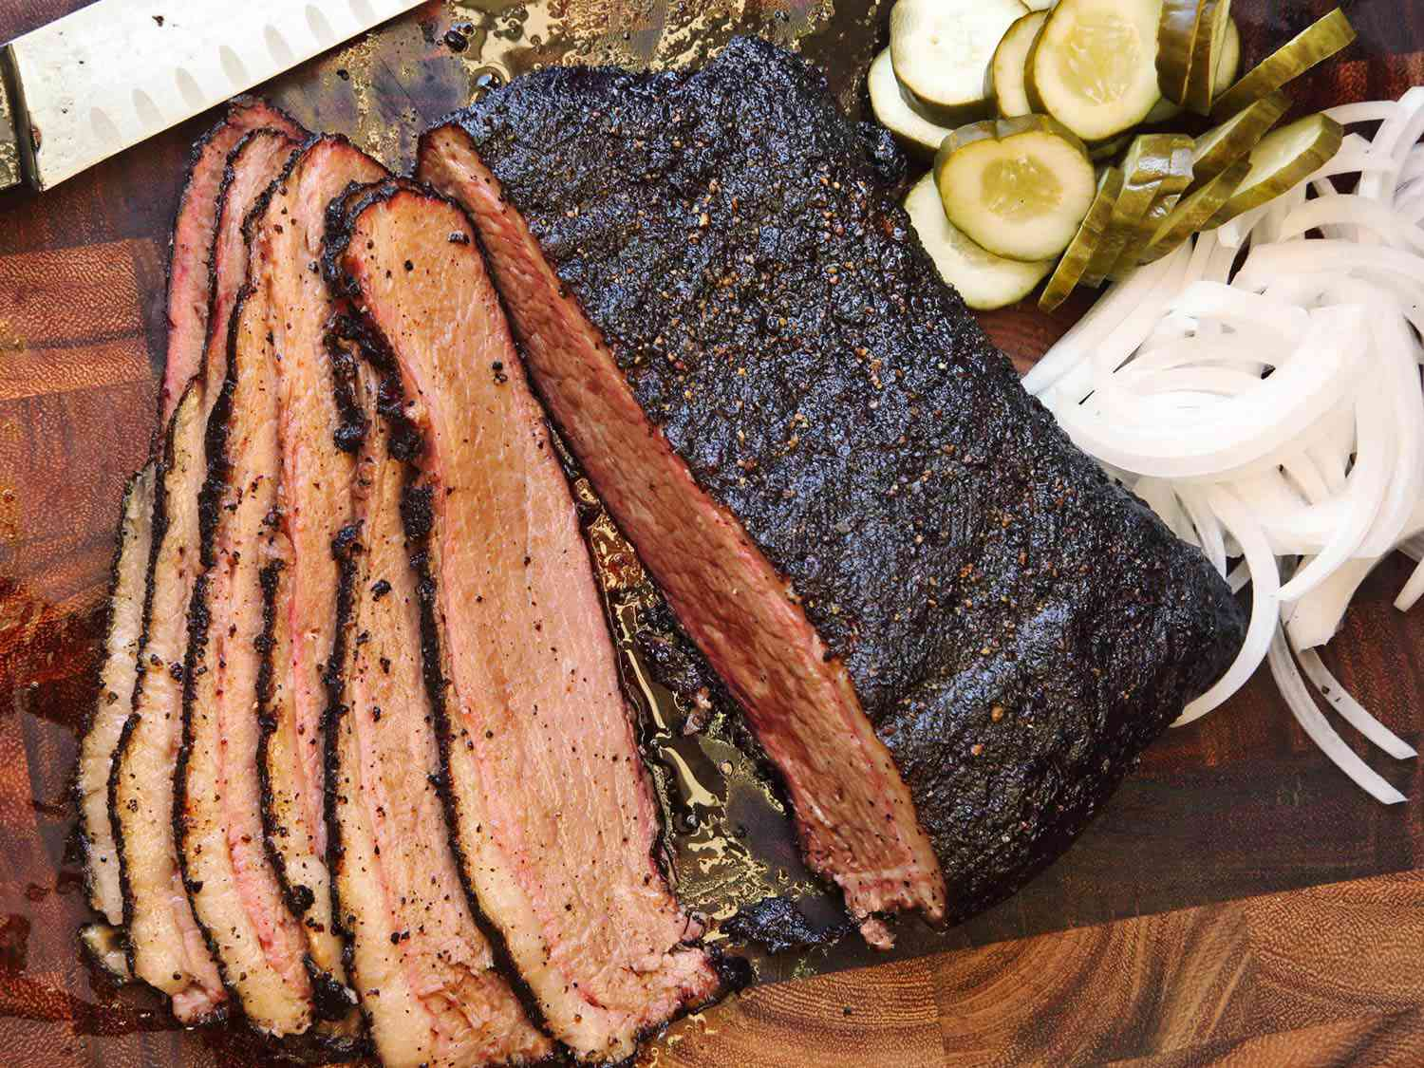
Overview
BBQ is…
Difficult and Laborious to Control
Requires experience for consistancy
Expensive!!!
Simplify the process
Make Cooking easier
Get Quality BBQ
Notes:
A. cooking Process takes several hours in some cases. To maintain fluctuating temperatures

Slide 4
Project Goal
Prototype a temperature sensor system that can analyse the relationship between a conventional smoker’s operating temperature and its level of ventilation.

Slide 5
Criteria
Our project tests our ability to integrate gathered data.
Implement our analysis and measurements into software that can be used to predict a real world outcome.
Our project will incorporate skills in programming to analyze and interpret data over a large period of time, and project this data to find a predictable outcome.
Notes:
Minjun
To give some criteria on our project, we need good quality barbecue that is cooked by amature college students maybe except for josh. As he explained, this is time consuming and requires a lot of skills. Our project, device set up, and code should make life easier to enjoy the barbecue.
This project does not only belong to data analysis. Our project Barbecue Bonanaze should come up with real world outcome, which is awesome brisket. This means our project should be able to bring the data like temperature to computer, analyze what is going on numerically, and control the smoker in a way that produces a good piece of Brisket.
So, not only the codes, we need to physically deal with the problems. Temperature sensors are going to be used to bring data to the computer. We need some skills from computational tool class. Also, our code should also be able to manage those data well.
After that, we need to analyze the data using numerical methods. Interpolation or fitting

Slide 6
Methods
Mount numerous temperature sensors inside smoker at different locations.
Levels of ventilation are recorded for given temperatures / rates of temperature increase.
Interpretation of this data to find and plot the relationship between temperature and ventilation.
Use interpolation / a fitting function to project necessary ventilation changes to achieve the target temperature.
Notes:
MinNjun
So basically, you put the sensors in the smoker arae, This would continuously measure the temperature over time.\
We are, then, going to have time over temperature plot in the end. With this data, we analyze what is going on. We need to know if the temperature is increasing or decreasing. This can be done by interpolating the data and see the trend of temperature changes
If the temperature is getting close to the upper limit, we nee d to do something to prevent overcooking. Such calculation will produce how long should we open the valve to keep the temperature in okay range

Slide 7
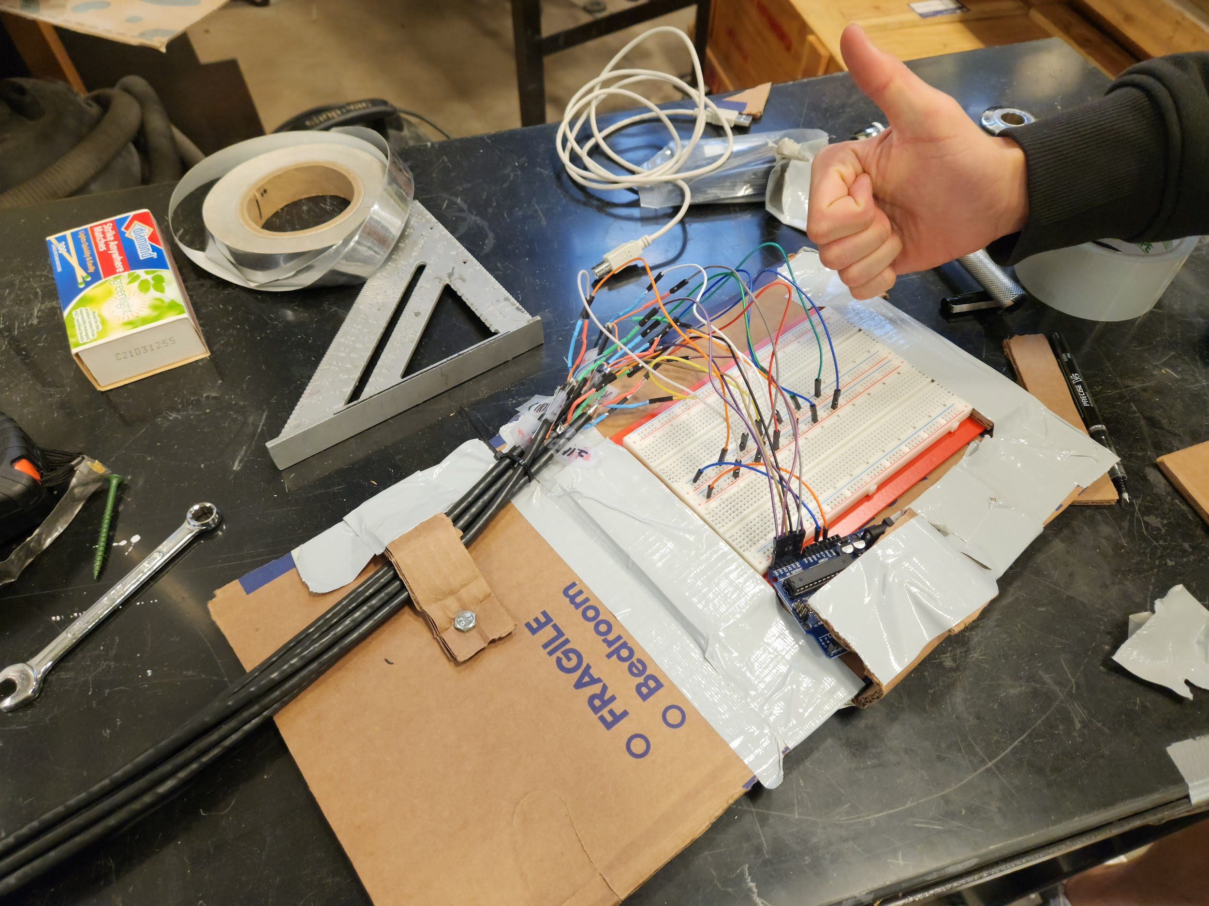
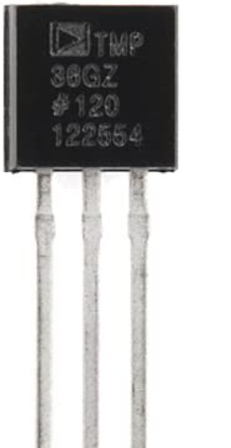
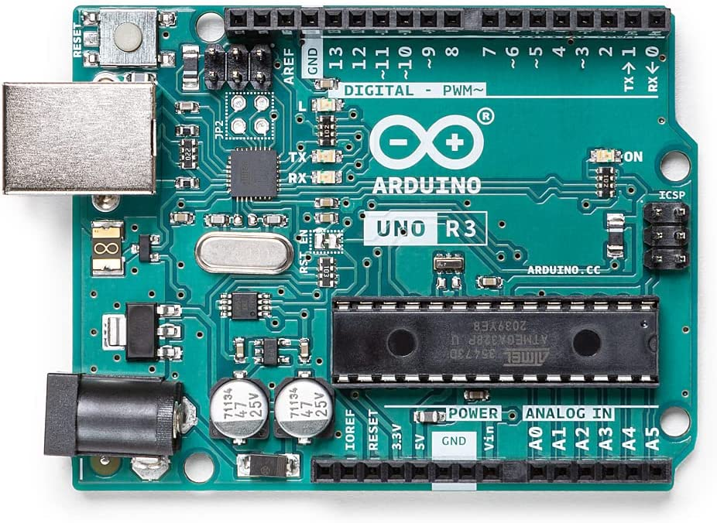
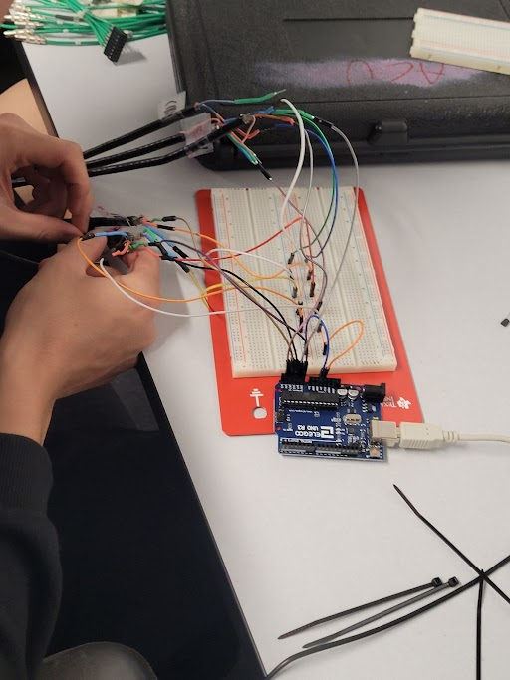
Setup: Hardware
Temperature Sensor (TMP 36)
Temperature Range: -40F to 302F
World Stiffest Cable
Connecting Wire
Bread Board
Arduino Board ( UNO REV3)

Slide 8
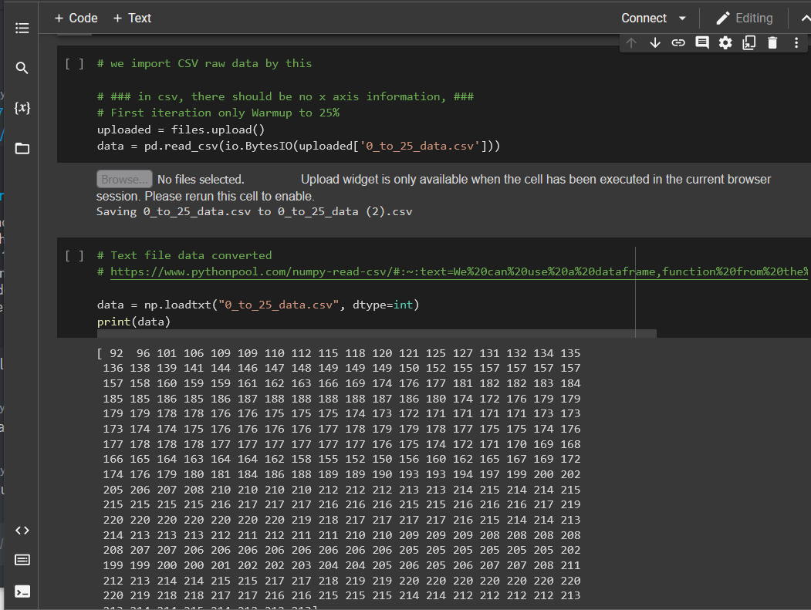
Setup: Software
Find average values for peak temperature at ventilation levels 25%, 50%, 75%, 100%
Fit a function to these values
Use this function to determine the temperature for any given percentage of ventilation.

Slide 9
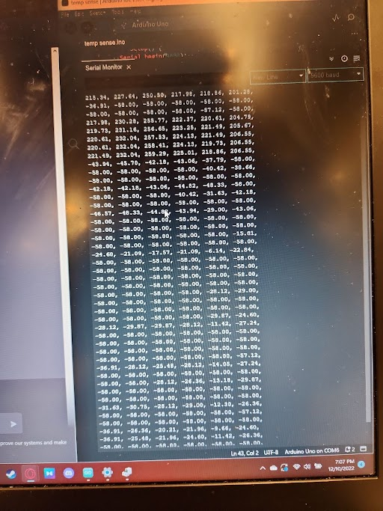
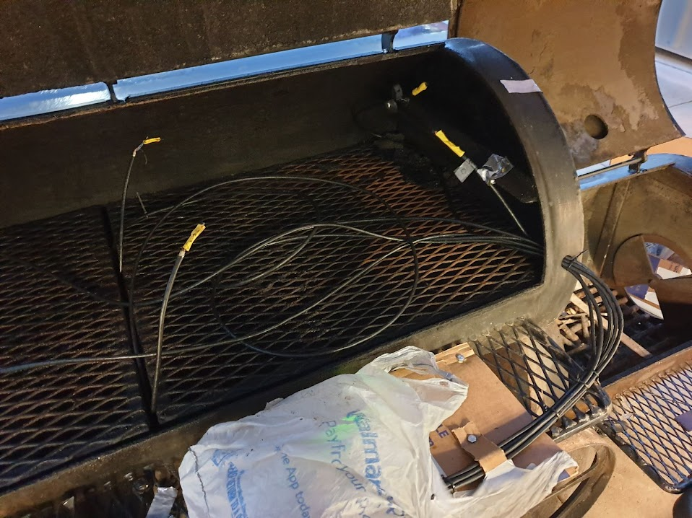
ISSUES!!?!?!
Notes:
We burnt our sensors…. And our dreams

Slide 10
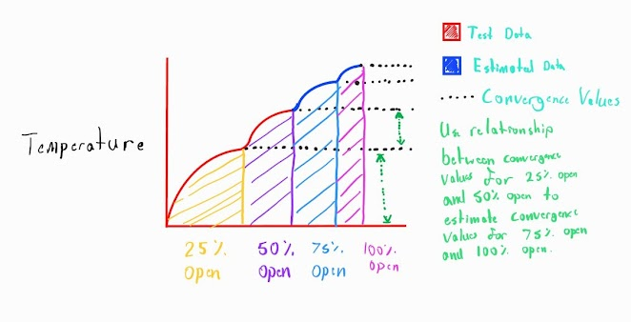
Solution
Extrapolate Gathered data to full data range.
Data gathered from start up to 50% open.
Plotted fully, data should follow a piecewise pattern, with each piece following a logarithmic curve.
Convergence value for each logarithmic curve is our average temperature for each ventilation level.
We must find the estimated convergence values for 75% open and 100% open.

Slide 11
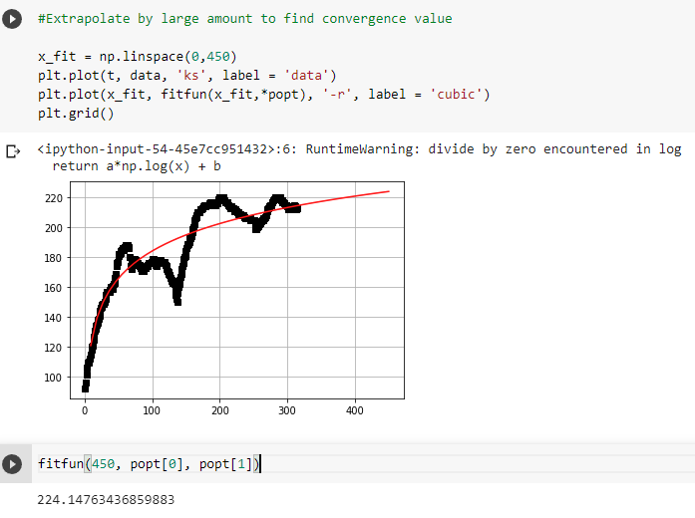
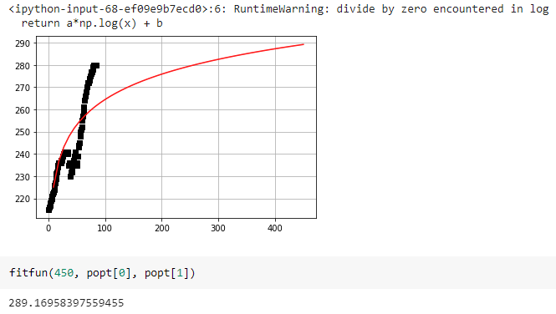

Slide 12
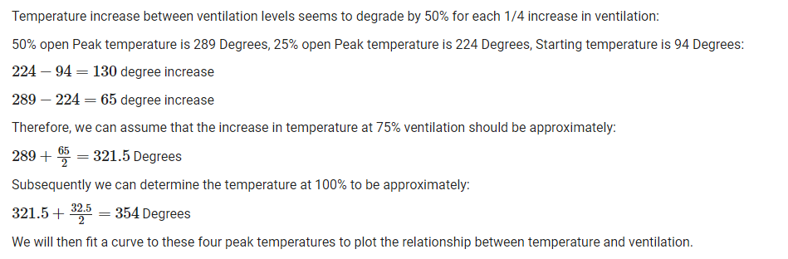

Slide 13
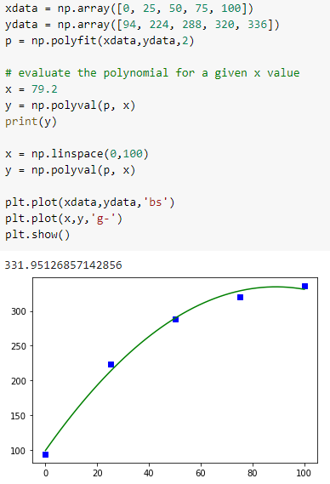

Slide 14
Shortcomings
Sensor system is fried
Can no longer definitively verify temperature estimations
Large margin of error
Outdoor temperature can affect results by a large margin.
Unable to verify results with actual BBQ
Time frame pushed significantly due to bad weather conditions. This negatively affected our schedule. Due to time restrictions, plans for actual BBQ is postponed.

